Slide 1
Information Systems
& Security

Slide 2
Basics of Information System
Data: raw facts
  Alphanumeric, image, audio, and video
Information: collection of facts organized in such a way that they have additional value beyond the value of the facts themselves
An Information System is a set of interrelated components that collect or retrieve, process, store and distribute information to support decision making and control in an organization.

Slide 3

Basics of Information System
IS accepts data from their environment and manipulate data to produce information that is used to solve a business problem or to help in taking business decisions.

Slide 4
Basics of Information System
Today Information Systems are mostly computerized, and software based.
Information System is made of hardware, software, data, procedures and people.
The major functions of an IS are-
  Input
  Storage
  Processing / manipulation
  Control
  Output

Slide 5
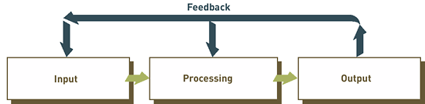
Basics of Information System
IS are developed to help specific business functions.
Some Examples are-
  Enterprise Resource Planning (ERP)
  Financial Management Information Systems (FMIS)
  Customer Relationship Management Systems (CRM)

Slide 6
Basics of Information System
Most common types of information systems used in business organizations
  Electronic and mobile commerce systems
  Transaction processing systems
  Management information systems
  Decision support systems
  Specialized business information systems

Slide 7
Basics of Information System
Electronic and Mobile Commerce
E-commerce: any business transaction executed electronically between parties
  Companies (B2B)
  Companies and consumers (B2C)
  Consumers and other consumers (C2C)
  Companies and the public sector
  Consumers and the public sector

Slide 8
Basics of Information System
Transaction Processing Systems
Transaction: business-related exchange
  Payments to employees
  Sales to customers
  Payments to suppliers
Transaction processing system (TPS): organized collection of people, procedures, software, databases, and devices used to record completed business transactions

Slide 9
Basics of Information System
Additional Business Information Systems
Management Information Systems (MIS)
  provide routine information to managers and decision makers
Knowledge Management Systems (KMS)
  create, store, share, and use the organization’s knowledge and experience
Artificial intelligence (AI)
  field in which the computer system takes on the characteristics of human intelligence
Decision support system (DSS)
  used to support problem-specific decision making

Slide 10
Basics of Information System
In the past decade, the nature of IS has undergone a great change, from Mainframe based IS to Client /Server to today’s Web based information system.
Information Systems today are distributed and component based.
Business now have no geographical boundaries.
Wide spread of internet and increase in bandwidth helped development of Global Information Systems.

Slide 11
Basics of Information System
Web services play a major role in building global IS for today’s dynamic business world.
Web services perform functions ranging from simple request to complicated business processes.
Advantages of GIS
  Strong Return-On-Investment (ROI)
  Increased Productivity
  Flexibility
  Low maintenance cost

Slide 12
Basics of Information System
Data Management
Without data and the ability to process it, an organization could not successfully complete most business activities
Data consists of raw facts
For data to be transformed into useful information, it must first be organized in a meaningful way

Slide 13
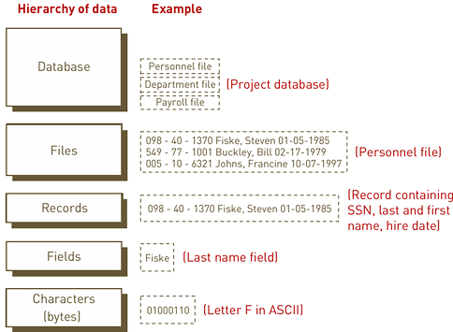
Basics of Information System

Slide 14
Basics of Information System
Data Management
Entity: a generalized class of people, places, or things (objects) for which data is collected, stored, and maintained
Attribute: characteristic of an entity
Data item: value of an attribute
Key: field or set of fields in a record that is used to identify the record
Primary key: field or set of fields that uniquely identifies the record

Slide 15
Basics of Information System
Data Management
Traditional approach to database management
  separate data files are created for each application
    Results in data redundancy (duplication)
    Data redundancy conflicts with data integrity
Database approach to database management:
  pool of related data is shared by multiple applications
    Significant advantages over traditional approach

Slide 16
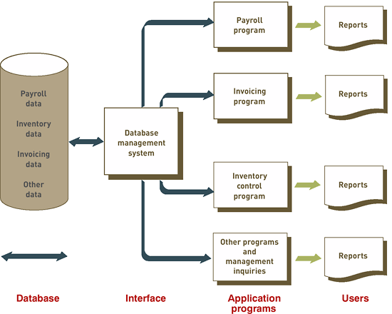
Basics of Information System
The Database Approach

Slide 17
Basics of Information System
Advantages of Database Approach
Improved strategic use of Organization data
  Accurate, complete and up to date data is available.
  It is available to decision makers when , where and in the required format they want.
Reduce Data Duplications
Easier updating and modifications
Data and Program Independence
Easier Control of data access
Improved Data Integrity
  Changes to data are available to all immediately.

Slide 18
Basics of Information System
Important facts When building a database
  Content: What data should be collected, at what cost?
  Access: What data should be provided to which users and when?
  Logical structure: How should data be arranged to make sense to a given user?
  Physical organization: Where should data be physically located?

Slide 19
Basics of Information System
Relational Database Model
data elements are placed in two-dimensional tables (relations), which are the logical equivalent of files
Each row of a table represents a data entity
Columns of the table represent attributes
The domain of the database model consists of all of the allowable values for data attributes

Slide 20
Basics of Information System
Database Management Systems (DBMS)
Interface between:
  Database and application programs
  Database and the user
Creating and implementing the right database system ensures that the database will support both business activities and goals
DBMS: a group of programs used as an interface between a database and application programs or a database and the user

Slide 21
Basics of Information System
IS design Considerations
Information systems planning: translating strategic and organizational goals into systems development initiatives
Aligning organizational goals and IS goals is critical for any successful systems development effort
Determining whether organizational and IS goals are aligned can be difficult

Slide 22
Basics of Information System
Tough competition forces business take correct decisions at perfect time.
Thus IS has become mandatory for businesses to perform their day-to-day functions.
As IS plays a crucial role in business systems, it is important that they remain secured.
Also the data contained in them should not fall into wrong hands.
Any problem with IS will result in
  Loss of productivity, loss of revenue, legal liabilities, loss of reputation and other losses.

Slide 23
Information System Security
Today most of the IS are connected to internet.
Thus they are exposed to the outside world directly.
Threats from the outside world must be addressed.
Damage from a non-secure IS can result in catastrophic consequences for the organization.
Thus organizations must investigate and evaluate the factors that could be a threat.

Slide 24
What Is Information Security???
Protection of information systems against unauthorized access to or modification of information, whether in storage, processing or transit, and against the denial of service to authorized users or the provision of the service to unauthorized users, including those measures necessary to detect, document, and counter such threats.
- U.S. Govt.’s NIA Glossary

Slide 25
Why Information Security???
Use of IT across businesses
Fast growth of Internet
Commercialization of Internet
Web site defacement
Theft of confidential data
Financial Frauds
Legal requirements

Slide 26
Why Information Security???
Increased rate of cyber crime issues.
Cyber crime is defined as criminal activity involving the IT infrastructure, including illegal access, illegal interception, data interference, misuse of devices, ID theft and electronic fraud.

Slide 27
Cyber Crime Techniques
Data Scavenging
Shoulder Surfing
Piggy Backing
Man In the middle
Social Engineering
Buffer overruns
SQL injections

Slide 28
Why Information Security???
Cookies
Cross Site Scripting (XSS)
SPAM
Denial Of Service (DOS)/ DDOS
Virus / Worms/ Trojans
Spyware / Adware
Phising
Spoofing …………………….. Etc.

Slide 29
Elements of Information Security
Three basic elements of Information Security.
Confidentiality
Integrity
Availability

Slide 30
Confidentiality
It is the principle that information will not be disclosed to unauthorized subjects.
Examples:
Unauthorized network data sniffing
Listening a phone conversation.

Slide 31
Integrity
It is the protection of system information or process from intentional or accidental unauthorized changes.

Slide 32
Availability
It defines that information or resources are available when required.

Slide 33
Information Security
In another words …….
……Information security means making sure to provide required information for the correct people at the correct time.

Slide 34
Other Elements of InfoSec
Identification – recognition of an entity by a system.
Authentication-Process of verifying identity.
Accountability –Tracing activities of individual on a system.
Authorization- Granting access or other permissions.
Privacy- Right of individual to control the sharing of information about him.

Slide 35
How to achieve Information Security???
Information Security does not mean only installing antivirus and firewalls.
Information security tends to protect hardware, software, data, procedures, records, supplies and human resources.
Information assets are those resources that store, transport, create, use or are information.

Slide 36
How to achieve Information Security???
Administrative Controls- Policies, standards, procedures, guidelines, employee screening, change control, Security awareness trainings.
Technical Controls- Access controls, encryption, Firewalls, IDS, IPS,HTTPS
Physical Controls- controlled physical access to resources, monitoring, no USB or CDROM etc.

Slide 37
How to achieve Information Security???
Information Security is the responsibility of everyone who can affect the security of a system.

Slide 38
Some Good Habits
Always use official software.
Keep all software uptodate with patches.
If using free software always download from original developers site.
Do not disclose all your information on internet sites like orkut/Facebook.
Use Internet with control.
Use email properly.
Take care while discarding your waste material.
Use small gadgets carefully as information storage.
Be careful while surfing from a cybercafe.

Slide 39
Information System Security
Threat
    A threat is a possible event that can damage or harm an Information System.
Vulnerability
  It is the weakness within a system. It is the degree of exposure in view of threat.
Countermeasures
  It is a set of actions implemented to prevent threats.

Slide 40
Information System Security
Network Level Threats
  Attacker requires network access to organization systems or networks.
  Hacking Computers, Implementing Spywares
Information Level Threats
  Attack on the information.
  Sending fake queries to sales department
  Submitting false information.
  Creating revenge web sites.

Slide 41
Information System Security
Major Security Threats to an IS
  Computer Crimes / Abuse
  Human Error
  Failure of Hardware or Software
  Natural Disasters
  Political Disasters

Slide 42
Information System Security
Computer Crime / Abuse
Computer Viruses
  A code that performs malicious act.
  Can insert itself into other programs in a system.
  Worm is a virus that can replicate itself to other systems using network.
  Biggest threat to personal computing.
Trojan Horse
  A program that performs malicious or unauthorized acts.
  Distributed as a good program.
  May be hidden within a good program.

Slide 43
Information System Security
Denial of Service (DoS)
  Making system unavailable to legitimate users.
Impersonation
  Assuming someone else’s identity and enjoying his privileges.
Salami Technique
  Diverting small amount of money from a large number of accounts maintained by the system.
  Small amounts go unnoticed.
Spoofing
  Configuring a computer to assume some other computers identity.

Slide 44
Information System Security
Scavenging
  Unauthorized access to information by searching through the remains after a job is finished.
  Dumpster diving
Data Leakage
  Various techniques are used to obtain stored data
  SQL injection
  Error Outputs
Wiretapping
  Tapping computer transmission lines to obtain data.
Theft of Mobile Devices

Slide 45
Information System Security
Myths, rumors and hoaxes
  Created by sending false emails to as many people as possible.
  These may have significant impact on companies, their reputation and business.
Web Site Attacks
  Web site defacement
  Adding wrong information
Increase in cyber crime rates
  Organized cyber criminals

Slide 46
Information System Security
  Employee Issues
    Disgruntle Employees
    Availability of hacking tools
  Social Engineering Attacks
    Sharing Passwords
    Sharing Official Systems
    Not following clean desk policy
  Rise in Mobile workers
    Use mobile devices
    Wireless access
    Lots of organization data exposed

Slide 47
Classification of Threats
Basic of the effective Security Management.
Organization require to know the damage caused when security incident or an attack happens.
This helps management to decide the budget for security related expenditures.
Organizations can not secure everything.
Organizations can not spend too much on security.

Slide 48
Classification of Threats
Five things to be considered while evaluating threat
Asset
  Something of value to the organization
Actor / Attacker
  Who or what may violate the security requirement
Motive
  Deliberate or accidental
Access
  How the attacker will access the asset.
Loss
  Loss due a threat

Slide 49
Classification of Threats
Types of assets
  Hardware
  Software
  Information
  Systems
  People

Slide 50
Classification of Threats
Classify Assets
Tag Assets based on their value to the organization.
Find various threats to important assets.
Tag threats for an asset.
Find the threats which have maximum risk.
Calculate the loss due to these threats.

Slide 51
Classification of Threats
Cost of a threat can be calculated considering following factors
  Productivity
    No. of employees affected
    No. of hours wasted
    Cost per hour / per employee
  Revenue
    Direct financial loss
    Future business loss
  Financial Performance
    Credit rating and stock price
  Other Expenses
  Hidden Costs

Slide 52
Classification of Threats
Cost of a threat can be calculated considering following factors
  Other Expenses
    Overtime Costs
    Travel Expenses
    Third Party costs
    Equipment Rental Costs
  Hidden Costs
    Difficult to calculate
    Cost of damaged reputation
    Loss of faith by customers, bankers or vendors

Slide 53
Information System Security
The aim of the information system security is to protect organization assets.
If not fully protected at least limit damage to them.
Limit access to information to authorized users only.
Information systems controls play a crucial role to ensure secure operations of IS.
They safeguard the assets and the data within them.

Slide 54
Information System Security
The organization needs to develop a set of security policies, procedures and technological measures.
Information System Controls-
  Preventive Controls
    Prevent an error or attack
  Detective Controls
    Detect a security breach or incident
  Corrective Controls
    These control detect any error or incident and correct it.

Slide 55
Information Security Risk Assessment

Slide 56
Building Blocks of Information Security
Basic Terms and Definitions
Encryption
  Modification of data for security reasons prior to their transmissions so that it is not comprehensible without the decoding method.
Cipher
  Cryptographic transformation that operates on characters or bits of data.
Cryptanalysis
  Methods to break the cipher so that encrypted message can be read.

Slide 57
Building Blocks of Information Security
Electronic Signature
  Process that operates on a message to assure message source authenticity, integrity and non-repudiation.
Non-Repudiation
  Methods by which the transmitted data is tagged with sender’s identity as a proof so neither can deny the transmission.
Steganography
  Method of hiding the existence of data. The bit map images are regularly used to transmit hidden messages.

Slide 58
Building Blocks of Information Security
Identification
  It is a method by which a user claims his identity to a system.
Authentication
  It is the method by which a system verifies the identity of a user or another system
Accountability
  It is the method by which a system tracks the actions performed by a user or a process.
Authorization
  It is a method by which a system grants certain permissions to a user.
Privacy
  It is protection on individual data and information.

Slide 59
Building Blocks of Information Security
The Three Pillars of Information Security
Confidentiality
  It is related to the access to data.
  Any intentional or unintentional unauthorized disclosure of data will make data loose it’s confidentiality.
Integrity
  It is nothing but the trueness or correctness of data.
  Any unauthorized modifications to data affects integrity of that data.
Availability
  It means reliable and timely access to required data.

Slide 60
Building Blocks of Information Security
Terms for Information Classification
Unclassified
  Not so important information. Can be disclosed to public.
Sensitive but unclassified
  Information is somewhat important but if disclosed to public will not cause any damage
Confidential
  Unauthorized disclosure may cause some damage.
Secret
  Unauthorized disclosure may cause serious damage.
Top secret
  Unauthorized disclosure may cause vary serious damage.

Slide 61
Building Blocks of Information Security
How ever some organizations classify information as
  Public
  Sensitive
  Private
Following criteria are used to determine the classification of information
  Value
  Age
  Useful Life
  Personal Association

Slide 62
Introduction… Risk Assessment
Inability of corporations to protect themselves from cyber-risks has attributed to heavy financial losses, breaches of privacy, and even the downfall of corporations.
Cyber-risks are generated from hackers, malicious software, disgruntled employees, competitors, and many other sources both internal and external.
These external and internal cyber-attacks on corporate assets and an increasingly technology-savvy corporate management have led to a more appropriate awareness of the information security risks to corporate information.

Slide 63
Introduction
Understandably, information security is now a major concern for most corporations.
A recent survey reported that computer security is the critical attribute of corporate networks for 78 percent of corporate executives.
Another survey reported that security outweighed other concerns by a factor of three as the driving concern for IT improvements.
Many corporations are putting their money by increasing security spending.
In a survey of chief security officers, corporations have increased their information security budget fivefold to 30 percent of their IT budget.

Slide 64
Introduction
But even with all this spending, many corporate executives are unsure about the effectiveness of their information security programs or the security controls that have been put in place.
A survey found that 34 percent of organizations see their own security controls as inadequate to detect a security breach.
Thus organizations need a reliable method for measuring the effectiveness of their information security program.
An information security risk assessment is designed specifically for that task.
An information security risk assessment, when performed correctly, can give corporate managers the information they need to understand and control the risks to their assets.

Slide 65
Security Risk Assessment
A security risk assessment is an important element in the overall security risk management process.
Security risk management involves the process of ensuring that the risk posture of an organization is within acceptable bounds as defined by senior management.
There are four stages of the security risk management process

Slide 66
Four Stages of Risk Management
Security Risk Assessment
  objective analysis of the effectiveness of the current security controls that protect an organization’s assets and a determination of the probability of losses to those assets.
  A security risk assessment reviews the threat environment of the organization, the value of assets, the criticality of systems, the vulnerabilities of the security controls, the impact of expected losses, and recommendations for additional controls to reduce risk to an acceptable level.
  Based on this information the senior management of the organization can determine if additional security controls are required.

Slide 67
Four Stages of Risk Management
Test and Review
  Security testing is the examination of the security controls against the security requirements.
  Security controls are determined during the security risk assessment and tested during security testing efforts.
  Security testing is performed more frequently than security risk assessments.

Slide 68
Four Stages of Risk Management
Risk Mitigation
  Risks to an organization’s assets are reduced through the implementation of new security controls or the improvement of existing controls.
  Security risk assessments provide information to allow the senior management to make risk-based decisions for the development of new controls.
  Also helps in deciding expenditure of resources on security improvements on existing controls.
  Risk can be mitigated through corrections and additional controls or accepted or transferred.

Slide 69
Four Stages of Risk Management
Operational Security
  The implementation and operation of most security controls are performed by operational personnel.
  Daily and weekly activities such as applying patches, performing account maintenance, and
  providing security awareness training are essential for maintaining an adequate security posture.

Slide 70
NIST Definition
The periodic assessment of risk to agency operations or assets resulting from the operation of an information system is an important activity.
The risk assessment brings together important information for agency officials with regard to the protection of the information system and generates essential information required for the security plan.

Slide 71
NIST Definition
The risk assessment includes: (i) the identification of threats to and vulnerabilities in the information system; (ii) the potential impact or magnitude of harm that a loss of confidentiality, integrity, or availability would have on agency operations (including mission, functions, image, or reputation) or agency assets should there be a threat exploitation of identified vulnerabilities; and (iii) the identification and analysis of security controls for the information system.

Slide 72
Risk Assessment
Asset –
  assets are the information and resources that have value to the organization.
  Examples include buildings, equipments, personnel, organization reputation, business documents, and many other tangible and intangible items.
  It is useful to categorize or classify assets to organize asset protection requirements, and the vulnerability assessment of assets.

Slide 73
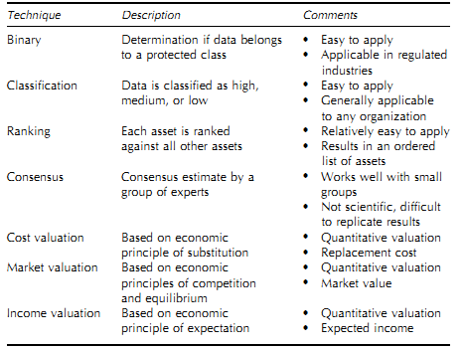
Risk Assessment
Asset Valuation
  One of the key steps to performing a security risk assessment is to determine the value of the assets that require protection.
  Various types of asset valuation techniques used.

Slide 74
Risk Assessment
The actual cost of an asset is determined by the importance it has to the organization as a whole.
The following factors affect the cost evaluation of an asset-
  Current cost of the asset
  Cost to acquire or develop the asset
  Cost to maintain and protect the asset
  Value of the asset to the owner and users
  Cost others are willing to pay for the asset
  Cost to replace the asset
  Other business activities affected because of failure or unavailability of this asset

Slide 75
Risk Assessment
Determining the value of an asset is the first step to understand what security measures are required and what fund should be allocated to protect the asset.
The asset value should also be able to answer the question how much it could cost the company to not protect the asset.
It helps in performing effective cost/benefit analysis
It helps select specific countermeasures and safeguards
It helps understand organization about the assets really important.

Slide 76
Risk Assessment Methodologies
For Risk Assessment different standardized methodologies are used by the industries.
The SP 800-30 document is the risk methodology developed by NIST.
This is named “Risk Management Guide for Information Technology Systems”
It is considered a U.S. federal government standard.
It is specific to IT threats and how they relate to information security risk.

Slide 77
Risk Assessment Methodologies
It lays out the following steps:
  System Characterization
  Threat Identification
  Vulnerability Identification
  Control analysis
  Likelihood determination
  Impact analysis
  Risk determination
  Control recommendations
  Result documentation
It does not cover larger organizational threat types such as natural disasters, environmental issues etc.

Slide 78
Risk Assessment Methodologies
The second type of risk assessment methodology is Facilitated Risk Analysis Process.
Developed by Thomas Peltier.
It involves assessing only those systems that are critical.
This helps reduces costs and overcome time obligations.
It is normally used to analyze a single system, single application or a business process at a time.
It does not involve any mathematical calculations.
Requires a good experienced team members for the risk assessment team.

Slide 79
Risk Assessment Methodologies
Another methodology is Operationally Critical Threat, Asset, and Vulnerability Evaluation(OCTAVE).
This method is designed to help people manage and direct the risk evaluation for information security within their company.
This methodology relies on the concept that people working within the organization know what kind of risks they are facing and best understand what is needed.
The members of the risk assessment team undergo facilitated workshops.
The facilitator helps the team members understand the risk methodology.

Slide 80
Risk Assessment Methodologies
The team members then apply this to vulnerabilities and threats identified within their business units.
The NIST, FRAP and OCTAVE methodology basically considers IT security threats and information security risks.
The Australian and New Zealand methodology AS/NZS4360 provides a broader approach to risk management.
This considers company’s financial, capital, human safety and business decision risks.
However this is not designed for security.

Slide 81
Risk Assessment Methodologies
United Kingdom created a risk assessment methodology - Central Computing and Telecommunications Agency Risk Analysis and Management Method – CRAMM
It works in three stages – define objectives, assess risks and identify countermeasures.
It follows the basic structure of any risk methodology.
It basically provides automated tools in the form of questionnaires, assess dependency modeling, assessment formulas, compliancy reporting.
Some organizations develop their own risk assessment methodologies and tools.

Slide 82
Risk Assessment
Threat
  A threat is commonly described as an event with an undesired impact on the organization’s assets.
  The components of a threat include the threat agent and the undesirable event.
Threat Agent
  A threat agent is an entity that may cause a threat to happen
Undesirable Event
  An undesirable event is what is caused by a threat agent.
  The event is considered undesirable if it threatens a protected asset.
  Such events include destruction of equipment, disclosure of sensitive information, and unavailability of resources.

Slide 83
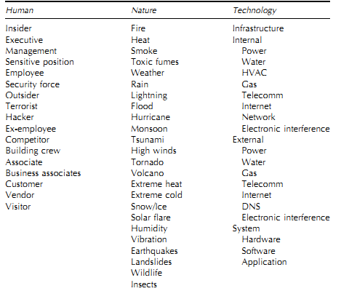
Risk Assessment
Threat Agents

Slide 84
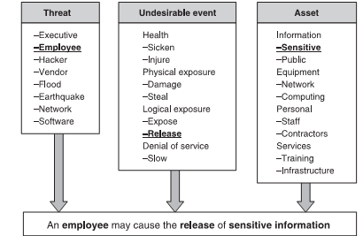
Risk Assessment
Threat Statements

Slide 85
Risk Assessment
Specific Threat Statements
  A vendor may accidentally cause the slow down of the computing equipment.
  A vendor may purposefully cause the slow down of the computing equipment.
The security risk assessment team is expected to use their experience, judgment, and common sense when assessing the validity of threat statements.

Slide 86
Risk Assessment
Factors affecting Threat Statement Validity
  History
  Environmental Factors
    Geography and Climate
    Facility Size and Configuration
    Social and Political Climate
  Business Factors
    Visibility
    Services Performed
    Value of Equipment and Inventories

Slide 87
Security Risk Assessment Approach
There are nearly as many security risk assessment approaches as there are organizations that perform them.
The first step in performing a security risk assessment is to clearly define and understand the approach to be taken.
There are many approaches for performing a security risk assessment.
These approaches vary in terms of analysis, measurement, use of tools, and the definition of the project phases defined.

Slide 88
Security Risk Assessment Approach
One of the differences between various security risk assessment techniques is the way they determine or calculate risk decision variables.
The important risk decision variables are …
  value of the asset;
  _x0001_
  likelihood that a vulnerability will be exploited; and
  _x0001_
  severity of the impact.

Slide 89
Security Risk Assessment Approach
The terms ‘‘likelihood’’ and ‘‘probability’’ are both used to describe how likely an event is to occur.
However, ‘‘likelihood’’ is used to qualitatively describe this occurrence and ‘‘probability’’ is used to quantitatively describe this occurrence.
Probability is a numerical measure of the chance of a specific event or outcome.

Slide 90
Security Risk Assessment Approach
The probability of an event is measured as the ratio of the sum of the events in question to the total number of possible events.
Therefore, probability is always a numerical value between 0 and 1, 0 indicating no chance of the event happening and 1 indicating that the event is certain to happen.

Slide 91
Security Risk Assessment Approach
When some computational method i.e. some formula is used to determine the values of the risk variables, it is called quantitative analysis.
Where as when it is done using subjective judgment approach is called qualitative analysis.

Slide 92
Security Risk Assessment Approach
Quantitative Analysis
Quantitative analysis is an approach that relies on specific formulas and calculations to determine the value of the risk decision variables.
These formulas cover the expected loss for specific risks and the value of safeguards to reduce the risk.
There are three classic quantitative risk analysis formulas –
  annual loss expectancy,
  single loss expectancy,
  safeguard value

Slide 93
Security Risk Assessment Approach
Quantitative Analysis
Single Loss Expectancy = Asset Value X Exposure Factor.
Annual Loss Expectancy (ALE) = Single Loss Expectancy X Annual Rate of Occurrence
Safeguard Value = ALE Before - ALE After - Annual Safeguard Cost.

Slide 94
Security Risk Assessment Approach
Quantitative Analysis
Single loss expectancy (SLE) is the expected loss as the result of a single incident.
An exposure factor is the average amount of loss to the asset for a single incident.
Annual rate of occurrence (ARO) is simply a prediction of how often a specific risk event is likely to happen each year.

Slide 95
Security Risk Assessment Approach
Quantitative Analysis
Safeguard value is defined as the reduction experienced in the annualized loss expectancy minus the annual cost of implementing the countermeasure.

Slide 96
Security Risk Assessment Approach
Qualitative Analysis
Qualitative analysis relies on the subjective judgment of the security risk assessment team to determine the overall risk to the information systems.
The same basic elements are required to determine risk, such as asset value, threat frequency, impact, and safeguard effectiveness, but these elements are now measured in subjective terms such as ‘‘high’’ or ‘‘not likely.’’

Slide 97
Security Risk Assessment Approach
Qualitative Analysis
Qualitative values have order.
These values are hierarchical. For example,
High > Medium > Low

Slide 98
Security Risk Assessment Approach
Quantitative Vs. Qualitative Analysis
Quantitative risk - A method of determining and presenting security risk that relies on specific formulas and calculations to determine the value of the security risk.
Advantages: Objective; security risk expressed in terms of dollars
Disadvantages: Security risk calculations are complex; accurate values are difficult to obtain

Slide 99
Security Risk Assessment Approach
Quantitative Vs. Qualitative Analysis
Qualitative risk - A method of determining and presenting security risk that relies on subjective measures of asset valuation, threats, vulnerabilities, and ultimately of the security risk.
Advantages: Easy to understand; provides adequate indication of the organization’s security risk
Disadvantages: Subjective; may not be trusted by some in management positions

Slide 100
Risk Mitigation Options
Risk Avoidance
  Avoid activities involving greater risk
  Use alternate solutions
Risk Termination
  Eliminate risk by removing the source
Risk Reduction
  Minimize probability of occurrence of risk
Risk Minimization
  Reduce the impact on the organization
Risk Transfer
  Insurance

Slide 101
Categories of controls
Technical
Management
Operational
Hybrid – combination of above

Slide 102
Technical Controls
Supporting Controls
  Identification, Cryptographic Key Management, Security Administration, System Protection
Preventive Controls
  Authentication, Authorization, Access Control Lists, Nonrepudiation,
Detection and recovering Controls
  Audits, Antivirus, Intrusion Detection System

Slide 103
Management Controls
Preventive Controls
  Assigning responsibilities, Security policies, Security awareness and training
Detection Controls
  Background Checks, Personnel Clearance, review of security controls, risk management
Recovery Controls
  Continuity plans, Incident response plans

Slide 104
Operational Security Controls
Preventive Controls
  Backups, UPS, Media access and disposal, Securing wiring closets, Controlling humidity and temperature.
Detection Controls
  CCTV camera, motion detectors, smoke detectors, fire alarms.

Slide 105
Residual Risk
The Risk that remains after the implementation of controls is called the residual risk.

Slide 106
Questions ??????

